Slide 1
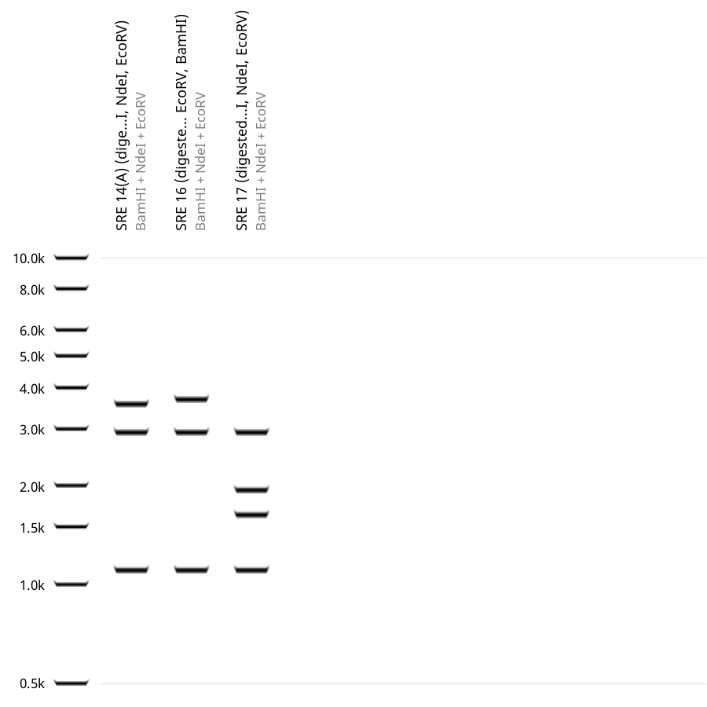
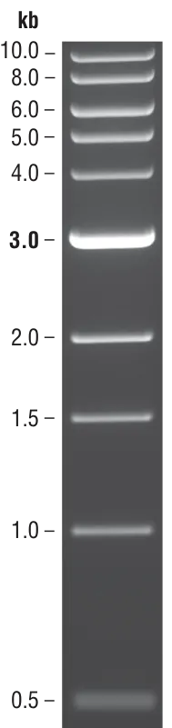
SRE Effectors; 18.06.2026
14A
16
17
14A
16
17
Notes:
Restriction-digest verification of SRE effector constructs. Agarose gel electrophoresis of restriction-digested SRE14A, SRE16 and SRE17 constructs, shown alongside their corresponding predicted virtual digest patterns. The observed banding profiles were consistent with the expected fragment patterns for the three effector constructs.

